Slide 1
JNCIS-ENT
Intermediate System to Intermediate System (IS-IS)

Slide 2
IS-IS Lab
7
Configuring, monitoring and troubleshooting multi-area IS-IS

Slide 3
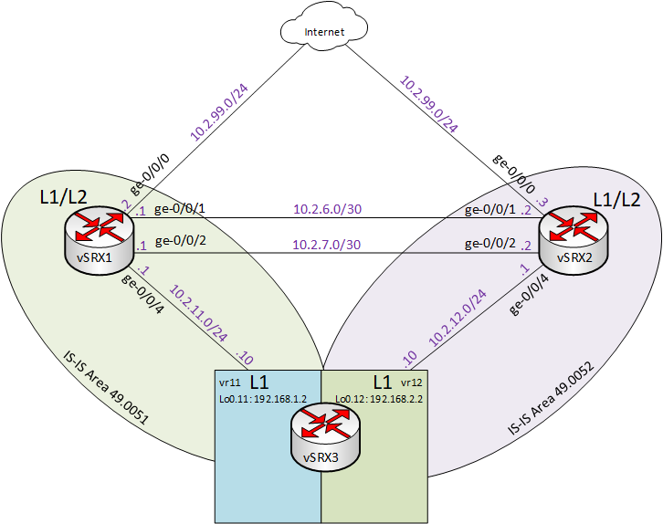
Diagram

Slide 4
Configuring and Monitoring ISIS
Review starting configurations on vSRX1, vSRX2, vSRX3
Review routing table for default routes on vSRX3
On vSRX1:
2. Set NET address and enable ISO protocol family on lo0.0
3. Enable ISO protocol family on interfaces ge-0/0/1.0, ge-0/0/2.0 and ge-0/0/4.0
4. Configure interfaces lo0.0, ge-0/0/1.0, ge-0/0/2.0 and ge-0/0/4.0 to participate in IS-IS
a. Ensure ge-0/0/4.0 can only form a level 1 adjacency
b. Configure lo0.0 as a passive interface
5. Review IS-IS adjacencies, interface, level 1 and level 2 database
6. Review routing table for default routes on vSRX3

Slide 5
Troubleshooting IS-IS
On vSRX1 set traceoptions on IS-IS for errors
On vSRX3, change the lo0.11 NET address to be in area 49.0053 instead of 49.0051
On vSRX1 review the effects of the incorrect area configuration in the trace log

